Slide 1
Programming Fundamentals
Course Code: CS-111
Course Instructor: Isra Naz

Slide 2
Goals for today:
Control flow statements
Switch statement

Slide 3

The switch statement should be used when you have a large decision tree and all decisions depend on value of a single variable.
It is an alternate to a ladder of nested if-else or else-if which may become complicated in case of multiple if-else choices.

Slide 4
Syntax
switch (expression) //expression may be integer or character variable
{
case constant 1:
statement(s);
break; // cause exit from case body
case constant 2:
statement(s);
break;
.
.
case constant n:
statement(s);
break;
default:
statement(s);
}

Slide 5
Working of ‘switch’ statement
Switch statement compares the result of a single expression with multiple cases.
Expression can be any valid expression that result in integer or character value.
The expression is evaluated at the top of switch statement and its result is compared with different cases.
Each case represent one choice
If result matches with any case, the corresponding block of statements is executed.
Any number of cases can be used in one switch statement.

Slide 6
 The expression evaluates to a value.
The expression is usually a variable or an expression that evaluates to a constant, e.g. 10, "a".
The data type of the case constants should match that of the switch variable.
Before entering switch, the program should assign a value to the switch variable.
This value matches a constant in one of the case statements.
If there is no match, the control goes to default case of the switch statement.
The break statement causes exit from the switch statement and control goes to the first statement following the switch statement block.

Slide 7
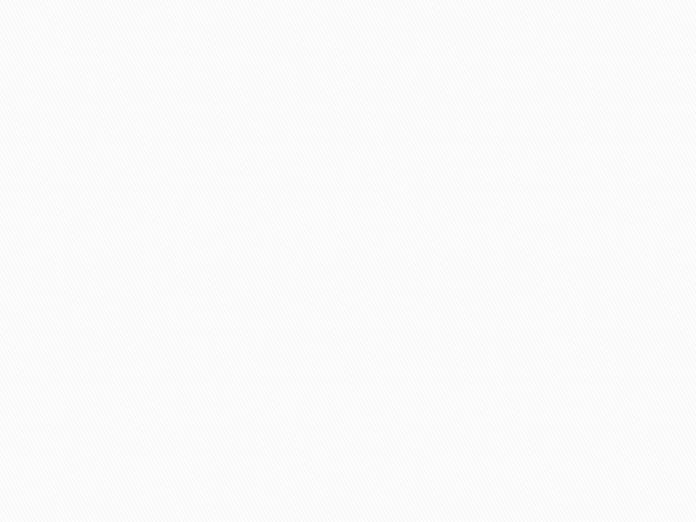

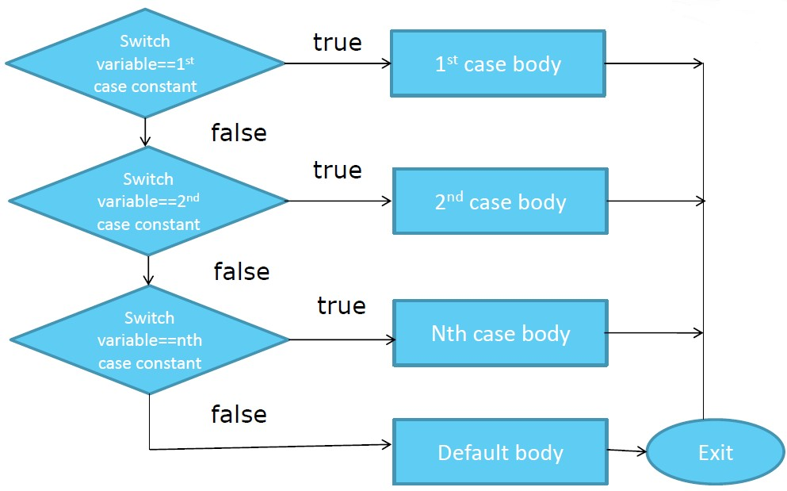

Slide 8
Working of ‘switch’ statement
The default label appears at the end of all cases block.
It is executed only when the result of expression does not match with any case label.
The break statement in each case is used to exit from switch body.
It is used at end of each case block
When the result of the expression matches with a case block, the corresponding statements are executed.
The break statement comes after these statements and the control exits from switch body.
If break is not used, all case blocks that come after the matching case will also be executed.

Slide 9
#include<iostream>
using namespace std; int main()
{
int op;
int a =20, b=10; cout<<“Enter operator to apply on a and b”;
switch(op)
{
case '+': cout<<a+b; break;
case '_':
cout<<a-b;
break; case '*':
cout<<a*b;
break;
case '/':
cout<<a/b; break;
default:
cout<<“wrong entry”;
} //end of switch
return 0;
}

Slide 10
Example 1 (switch statement)
case 45:
cout<<“you entered 45”;
break;
case 78:
cout<<“you entered 78”;
break;
default:
cout<<“invalid option”;
}
return 0;
}
#include<iostream>
Using namespace std;
int main
{
int x;
cout<<“Enter 33, 45 or 78: ”;
cin>> x;
switch(x)
{
case 33:
cout<<“you entered 33”;
break;

Slide 11
Difference between if-else and switch
If-else” and “switch” both are selection statements.
transfer the flow of the program to the particular block of statements based upon whether the condition is “true” or “false”.
if-else statement “selects the execution of the statements based upon the evaluation of the expression in if statements”.
The switch statements “selects the execution of the statement often based on a keyboard command.

Slide 12
Comparison
Basic difference:
In if-else statement Which statement will be executed depend upon the output of the expression inside if statement.
While in switch which statement will be executed is decided by user.
Expression:
if-else statement uses multiple statement for multiple choices.
While in switch
switch statement uses single expression for multiple choices.

Slide 13
Comparison(cont.)
Testing
if-else statement test for equality as well as for logical expression
While in switch
switch statement test only for equality.
Evaluation
if statement evaluates integer, character, pointer or floating-point type or Boolean type
While in switch
switch statement evaluates only character or integer value.

Slide 14
Comparison(cont.):
Sequence of Execution
Either if statement will be executed or else statement is executed
While in switch:
switch statement execute one case after another till a break
statement is appeared or the end of switch statement is reached
Default Execution
If the condition inside if statements is false, then by default the
else statement is executed if created
While in switch:
If the condition inside switch statements does not match with any of cases, for that instance the default statements is executed if created

Slide 15
Comparison (cont.)
Editing
It is difficult to edit the if-else statement, if the nested if-else statement is used
While in switch
It is easy to edit switch cases as, they are recognized easily

Slide 16
Difference b/w nested if-else and switch
Sr no | Switch | Nested if else
1 | It is easy to use when there are multiple choices | It is difficult to use when there are multiple choices
2 | It uses single expression for multiple choices. | It uses multiple expressions for multiple choices.
3 | It cannot check range of values. | It can check range of values.
4 | It checks only constant values. You cannot use variables with case statement | It can check variables also. You can use a constant or variable in relational expression.

Slide 17
Switch statement
The main advantage of switch statement over a sequence of if-else statements is that it is much faster
Jumping to blocks of code is based on a lookup table instead of a sequence of variable comparisons
The main disadvantage of switch statements is that the decision variable must be an integer (or a character)
We can not use a switch with a float or string decision variable or with complex logical expressions

Slide 18
Example 2
Write a program to input a single number from 0 to 9 and print the word in English representing this number, using switch statement

Slide 19
Solution
#include<iostream> using namespace std; int main( ) { int num; cout<<"Enter any number from 0 to 4: “<<endl; cin>>num; switch(num){ case 0: cout<<"\nzero"; break; case 1: cout<<"\nOne"; break; case 2: cout<<"\nTwo"; break; case 3: cout<<"\nThree"; break; case 4: cout<<"\nFour"; break; default: cout<<"\nOnly the numbers between 0 and 9 are allowed"; } return 0;}
Notes:
#include<iostream> using namespace std; int main( ) { int num; cout<<"\nEnter any number from 0 to 9 : "; cin>>num; switch(num){ case 0: cout<<"\nzero"; break; case 1: cout<<"\nOne"; break; case 2: cout<<"\nTwo"; break; case 3: cout<<"\nThree"; break; case 4: cout<<"\nFour"; break; case 5: cout<<"\nFive"; break; case 6: cout<<"\nSix"; break; case 7: cout<<"\nSeven"; break; case 8: cout<<"\nEight"; break; case 9: cout<<"\nNine"; break; default: cout<<"\nOnly the numbers between 0 and 9 are allowed"; } return 0; }

Slide 20
Menu example
How can we create a user interface for banking?
Assume user selects commands from a menu
We need to read and process user commands
We can use a switch statements to handle menu
Ask user for numerical code for user command
Jump to the code to process that banking operation
Repeat until the user quits the application

Slide 21
Menu example
// Simulate bank deposits and withdrawals
#include <iostream>
using namespace std;
int main()
{
// Local variable declarations
// Print command prompt
// Read user input
// Handle banking command
return 0;
}
For the first version of program we just write comments in the main program to explain our approach

Slide 22
Menu example
…
// Local variable declarations
int Command = 0;
// Print command prompt
cout << “Enter command number:\n”;
// Read user input
cin >> Command;
…
For the next version of program we add the code to read the user command

Slide 23
Menu example
// Handle banking command
switch (Command)
{
case 0: // Quit code
break;
case 1: // Deposit code
break;
case 2: // Withdraw code
break;
case 3: // Print balance code
break;
}
Then we add the skeleton of the switch statement to handle the user command

Slide 24
Menu example
// Simulate bank deposits and withdrawals
#include <iostream>
using namespace std;
int main()
{
// Local variable declarations
int Command = 0;
int Money = 0;
int Balance = 100;
// Print command prompt
cout << “Enter command number:\n”
<< “ 0 - quit\n”
<< “ 1 - deposit money\n”
<< “ 2 - withdraw money\n”
<< “ 3 - print balance\n”;
In the final version add bank account variables and add code to perform banking operations

Slide 25
Menu example
// Read and handle banking commands
cin >> Command;
switch (Command)
{
case 0: // Quit code
cout << “See you later!” << endl;
break;
case 1: // Deposit code
cout << “Enter deposit amount: “;
cin >> Money;
Balance = Balance + Money;
break;

Slide 26
Menu example
case 2: // Withdraw code
cout << “Enter withdraw amount: “;
cin >> Money;
Balance = Balance - Money;
break;
case 3: // Print balance code
cout << “Current balance = “ << Balance << endl;
break;
default: // Handle other values
cout << “Ooops try again” << endl;
break;
}
// Print final balance
cout << “Final balance = “ << Balance << endl;}

Slide 27
Programming tips
Common programming mistakes
Missing or unmatched ( ) brackets in logical expressions
Missing or unmatched { } brackets in conditional statement
Missing break statement at bottom of switch cases
Never use & instead of && in logical expressions
Never use | instead of || in logical expressions
Never use = instead of == in logical expressions
Never use “;” directly after logical expression

Slide 28
Yours Turn
Write a program that inputs a character from the user and checks whether it is a vowel or consonant.

Slide 29
Sol
int main()
{
char c;
cout<<“Enter an alphabet:”;
cin>>c;
switch(c)
{
case ‘a’:
case ’A’:
cout<<“You entered vowel”;
break;
case ‘e’:
case ’E’:
cout<<“You entered vowel”;
break;

Slide 30
Sol
case ‘i’:
case ’I’:
cout<<“You entered vowel”;
break;
case ‘o’:
case ’O’:
cout<<“You entered vowel”;
break;
case ‘u’:
case ’U’:
cout<<“You entered vowel”;
break;
default:
cout<<“You enter consonant.”;
}
}

Slide 31
A program that inputs number for week days and displays the name of the day.

Slide 32
A program that inputs number for weekdays and displays the name of the day.
int main()
{
int n;
cout<<“Enter number of a weekday:”;
cin>>n;
switch(n)
{
case 1:
cout<<“Friday”;
break;
case 2:
cout<<“Saturday”;
break;

Slide 33
case 3:
cout<<“Sunday”;
break;
case 4:
cout<<“Monday”;
break;
case 5:
cout<<“Tuesday”;
break;
case 6:
cout<<“Wednesday”;
break;
case 7:
cout<<“Thursday”;
break;
default:
cout<<“Invalid number”;
}
}

Slide 34


